Slide 1

CSS3
Rakesh Kumar

Slide 2
Intro to CSS
HTML is used to define the structure and semantics of web page, Cascading Style Sheets (CSS) is used to style it and lay it out.

Slide 3
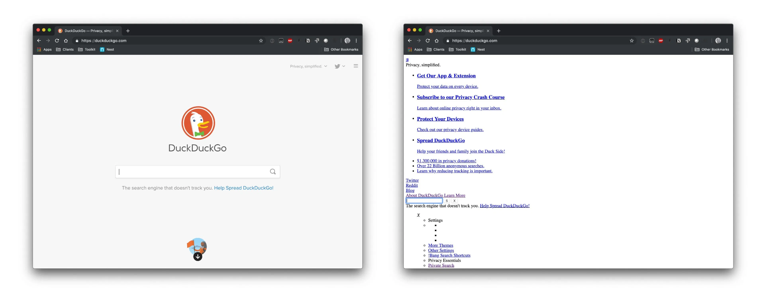
Web page with and without CSS

Slide 4
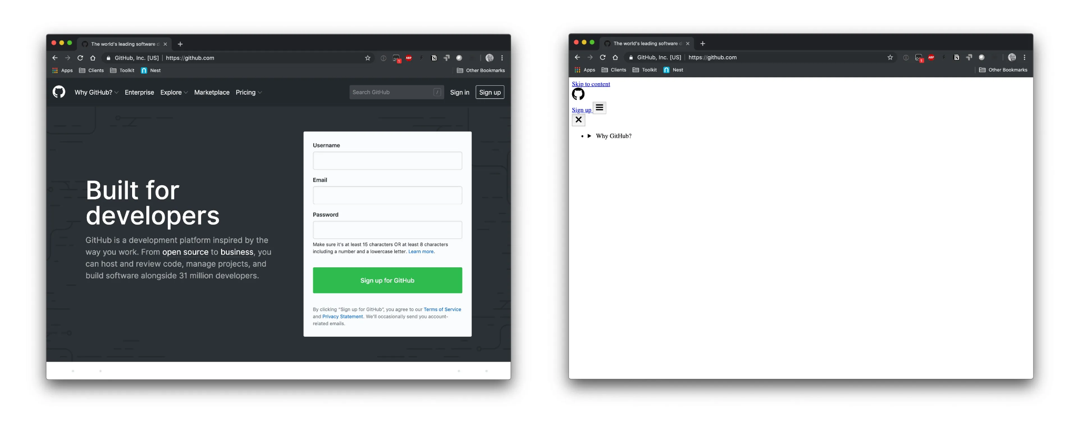
Web page with and without CSS

Slide 5
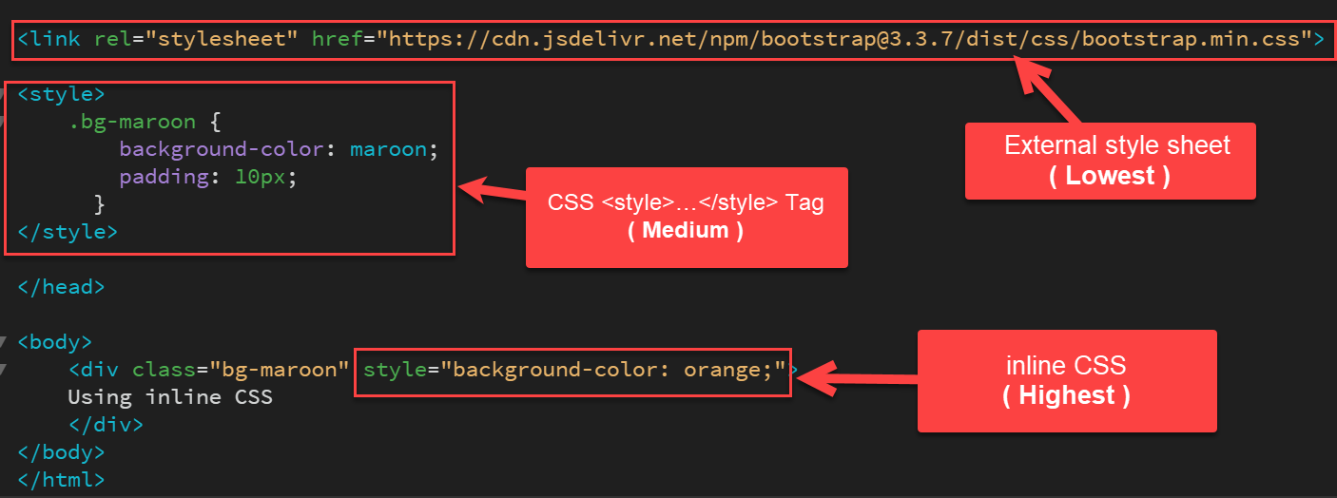
How to add CSS

Slide 6
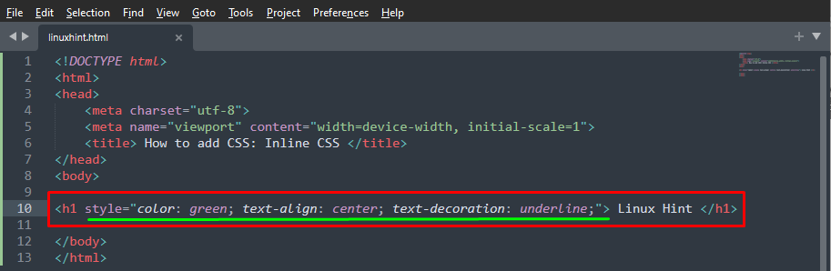
How to add CSS - Inline

Slide 7
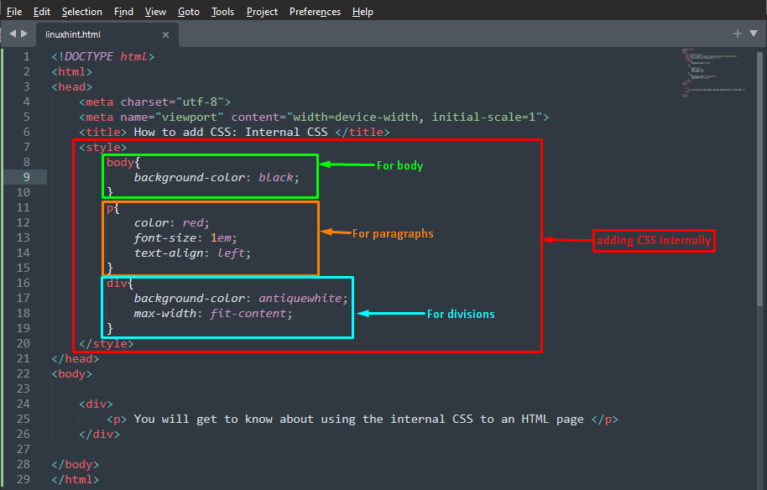
How to add CSS - Internal

Slide 8
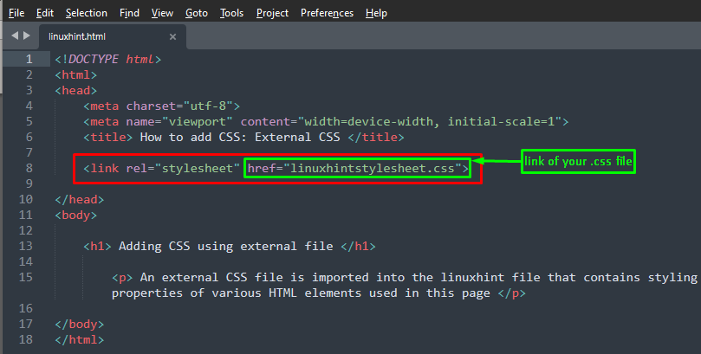
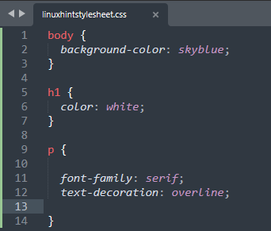
How to add CSS - External

Slide 9
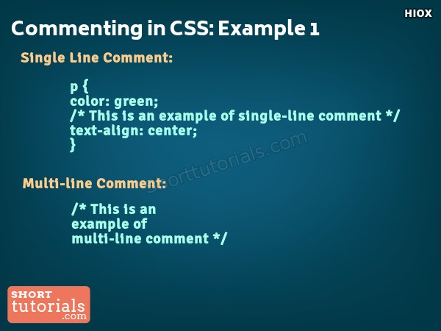
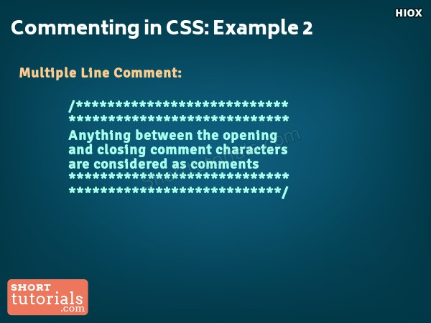
CSS comments

Slide 10
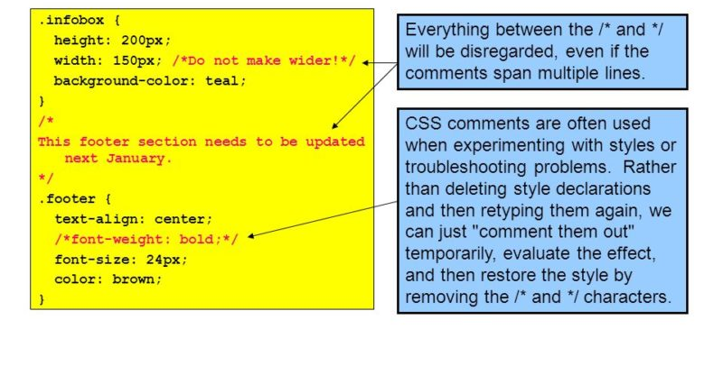
CSS comments

Slide 11
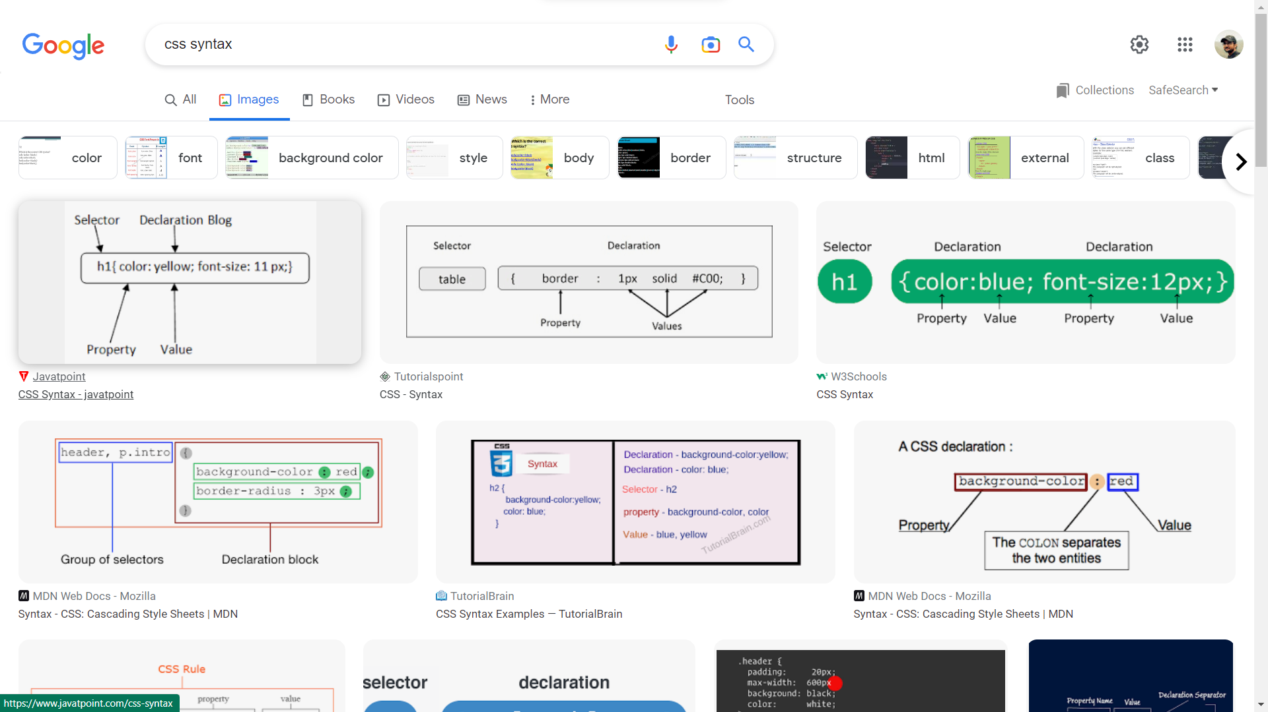
CSS Syntax

Slide 12
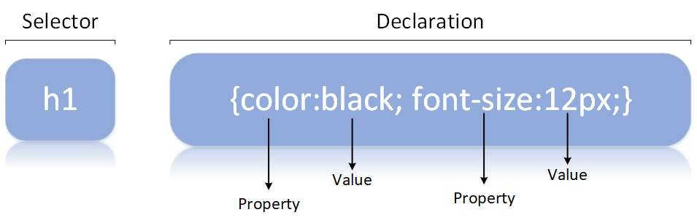
CSS syntax

Slide 13
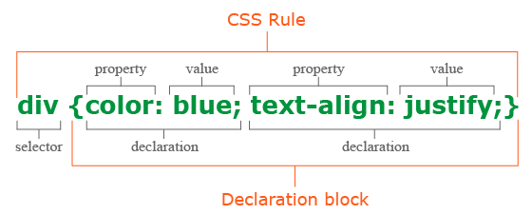
CSS syntax

Slide 14
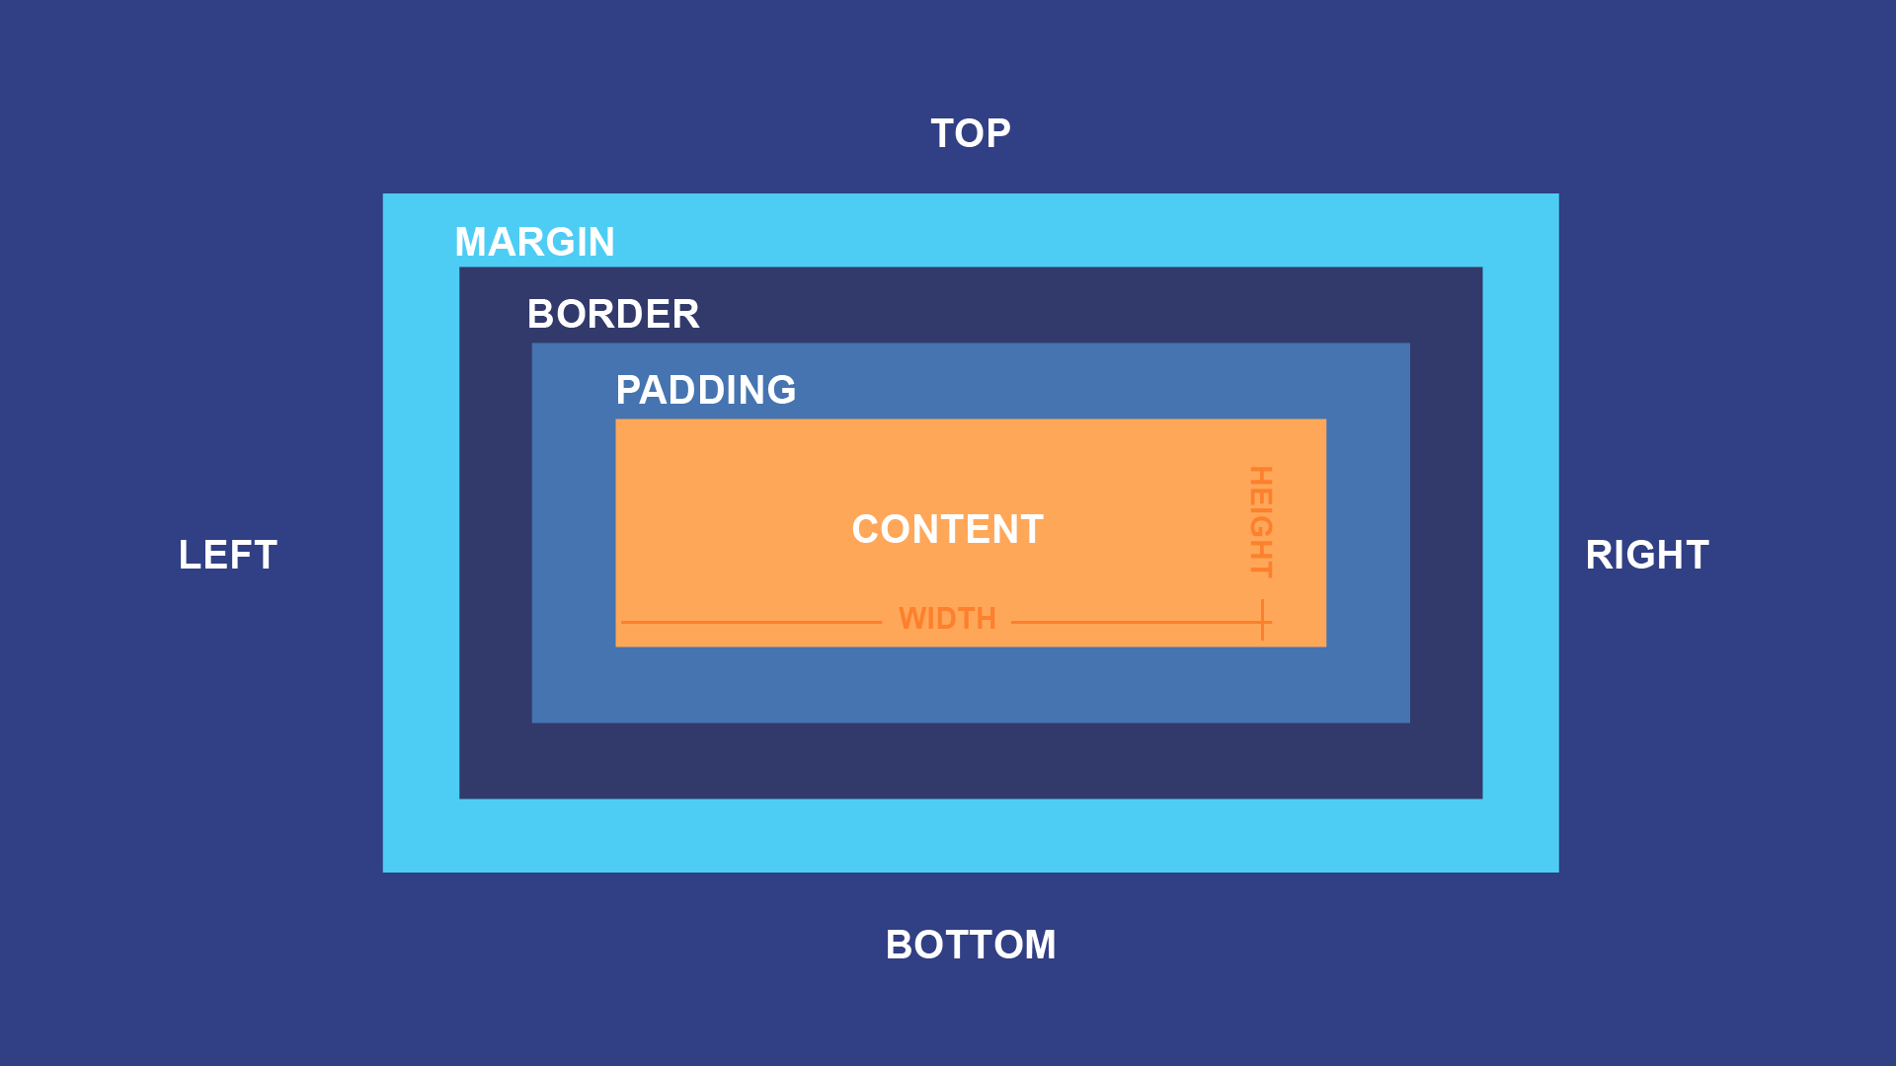
CSS Box Model

Slide 15
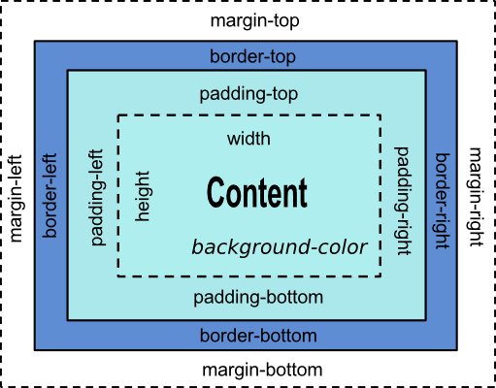
CSS Box Model

Slide 16
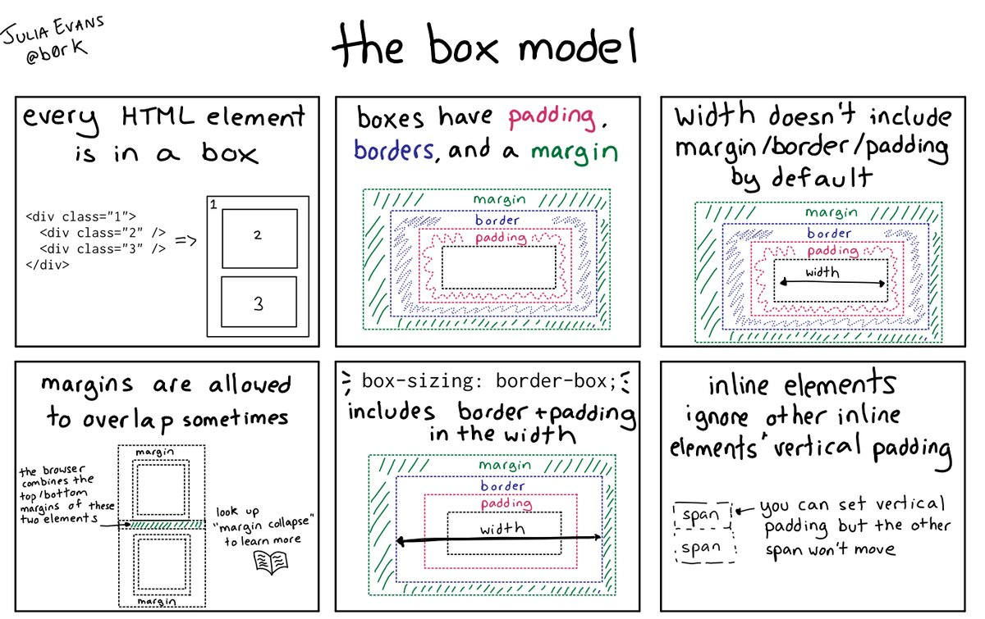
CSS Box Model

Slide 17
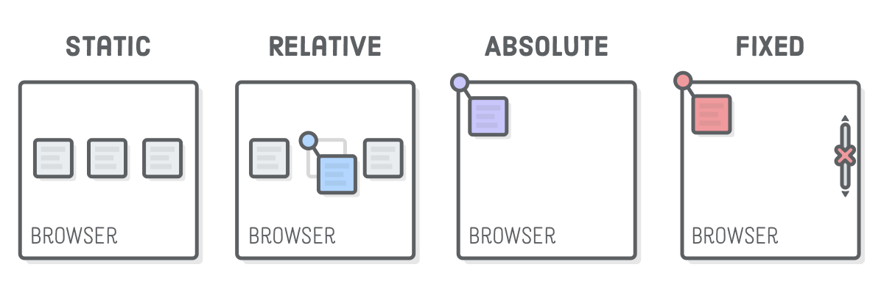
CSS Position Properties

Slide 18
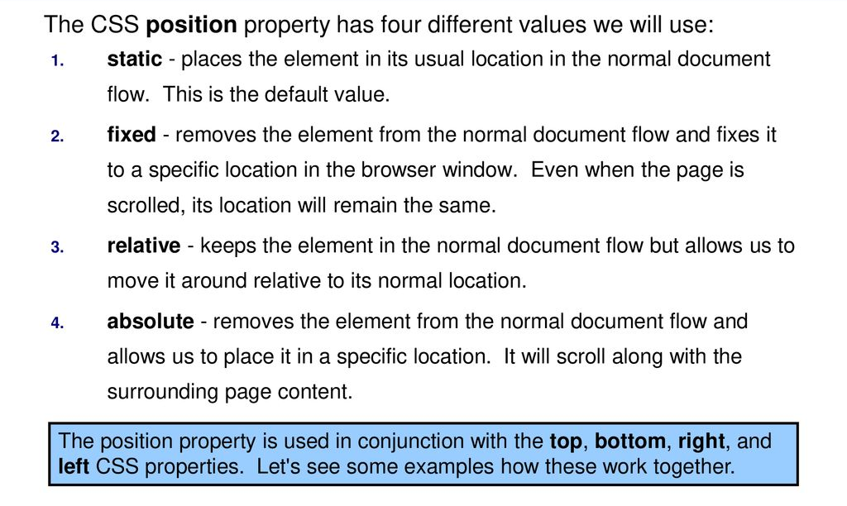
CSS Position Properties

Slide 19
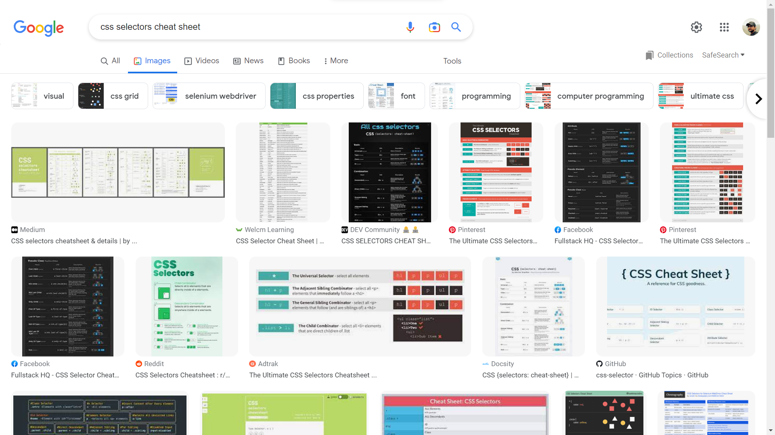
CSS Selectors

Slide 20
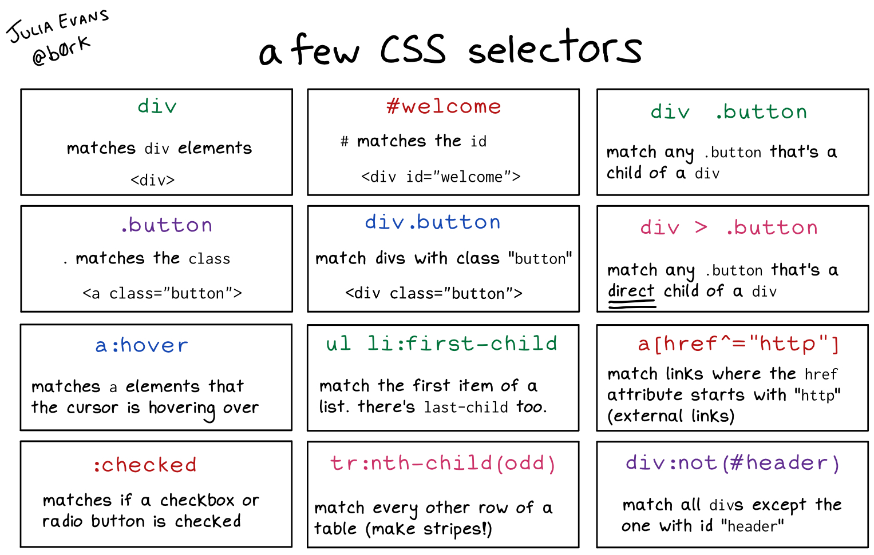
CSS Selectors

Slide 21
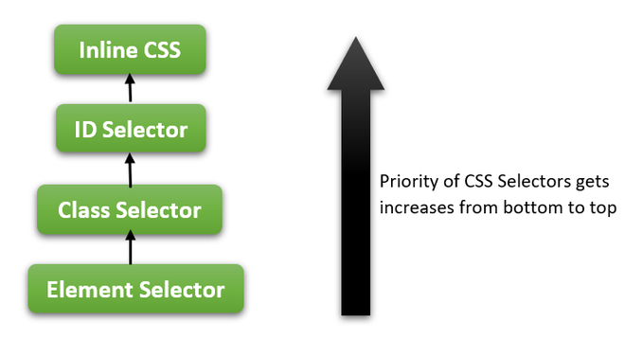
CSS Specificity

Slide 22
Background Properties
background-color Specifies the background color to be used
background-image Specifies ONE or MORE background images to be used
background-position Specifies the position of the background images
background-size Specifies the size of the background images
background-repeat Specifies how to repeat the background images
background-origin Specifies the positioning area of the background images
background-clip Specifies the painting area of the background color and images
background-attachment Specifies whether the background images are fixed or scrolls with the rest of the page

Slide 23
Background Shorthand Property
The background property is a shorthand property for:
background-color
background-image
background-position
background-size
background-repeat
background-origin
background-clip
background-attachment
It does not matter if one of the values above are missing:
background: orange url("pattern-1.jpg") no-repeat fixed center;

Slide 24
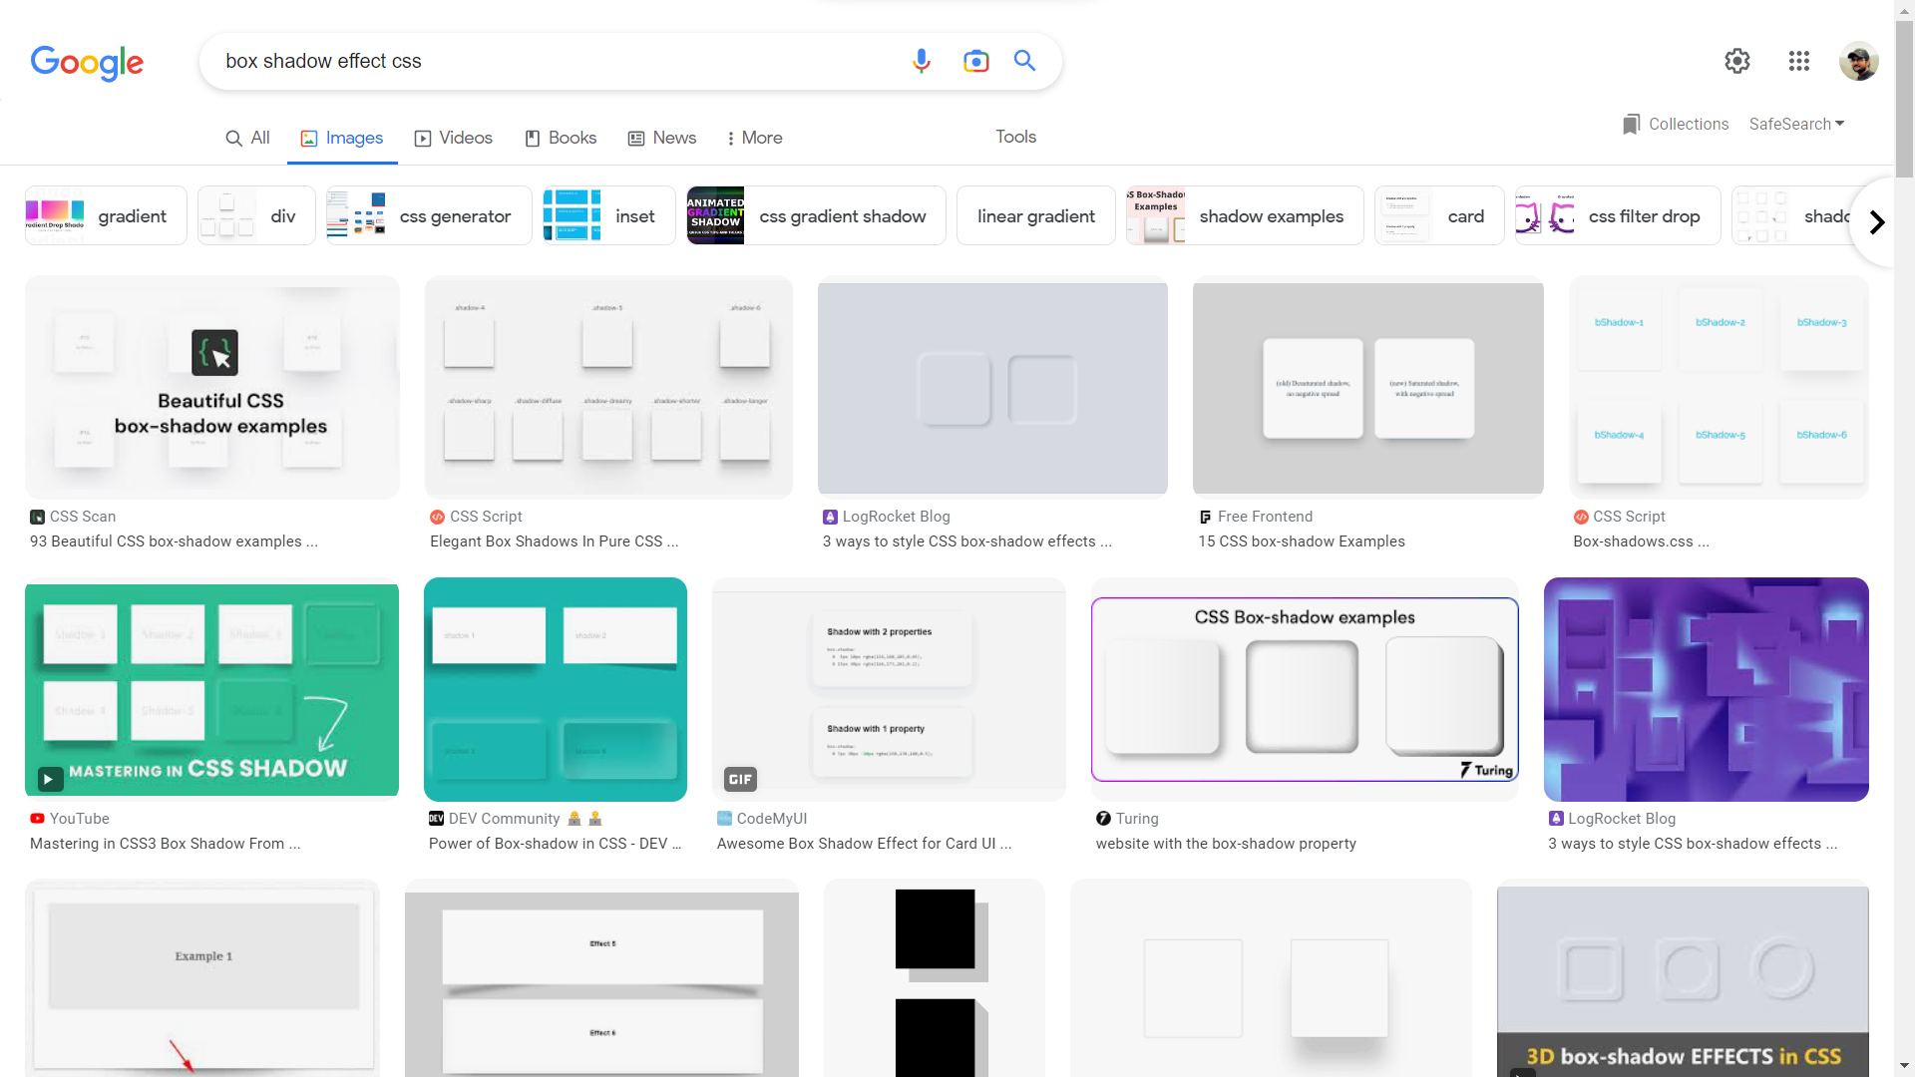
Box Shadow Properties

Slide 25
Box Shadow Properties
none Default value. No shadow is displayed
h-offset Required. The horizontal offset of the shadow.
v-offset Required. The vertical offset of the shadow.
blur Optional. The blur radius.
spread Optional. The spread radius.
color Optional. The color of the shadow.
inset Optional. Changes the shadow from an outer shadow (outset) to an inner shadow
box-shadow: none | h-offset v-offset blur spread color | inset;

Slide 26
Animation Properties
none Default value. No shadow is displayed
h-offset Required. The horizontal offset of the shadow.
v-offset Required. The vertical offset of the shadow.
blur Optional. The blur radius.
spread Optional. The spread radius.
color Optional. The color of the shadow.
inset Optional. Changes the shadow from an outer shadow (outset) to an inner shadow
box-shadow: none | h-offset v-offset blur spread color | inset;

Slide 27
CSS Practice

Slide 28

CSS Practice

Slide 29
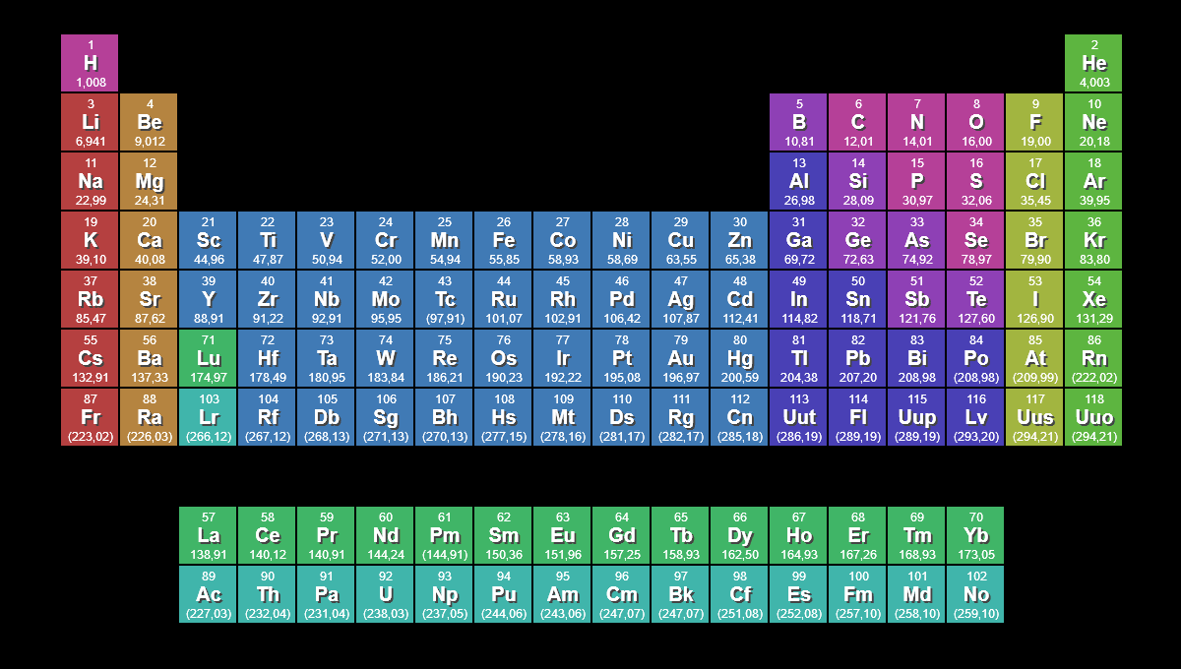
CSS Practice

Slide 30
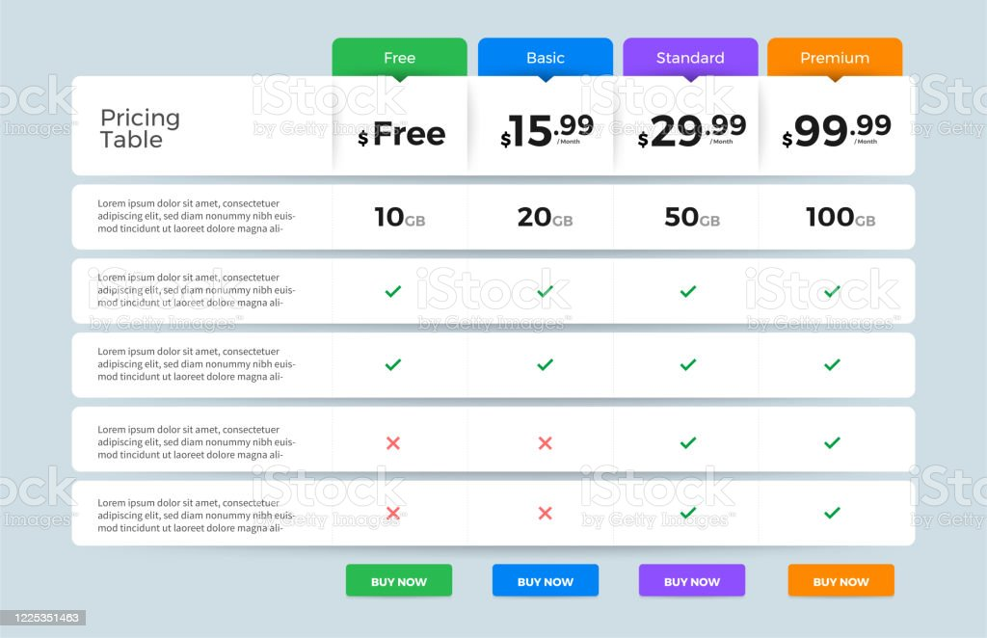
CSS Practice

Slide 31

CSS Practice

Slide 32

CSS Practice

Slide 33
References:
https://developer.mozilla.org/en-US/docs/Learn/CSS
https://web.dev/learn/css
https://flexbox.tech/
https://box-shadow.dev/
https://appletree.or.kr/quick_reference_cards/CSS/CSS%20selectors%20cheatsheet.pdf
https://welcm.uk/downloads/CSS-Selectors-Cheatsheet.pdf
https://developer.mozilla.org/en-US/docs/Web/CSS/CSS_Animations/Using_CSS_animations
https://developer.mozilla.org/en-US/docs/Web/CSS/CSS_Transitions

